Slide 1
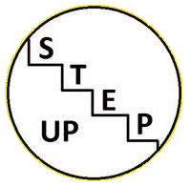
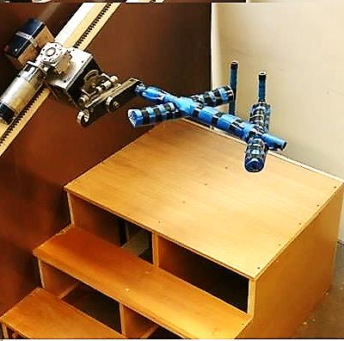
Step Up
Group 8
Paula Murphy
Tadhg Brennan
Craig Kennedy
Varun Soni
Jonathan Douglas - Smith
Moving forward one step at a time
School of Mechanical and Manufacturing Engineering
3B8 Universal Innovative Design

Slide 2
Needfinding Activities
Stakeholders:
Brainstormed as a group to come up with potential stakeholders
Approached the potential stakeholders and explained the project to them to see if they would be willing to take part.
Prepared survey questions and interviewed stakeholders.
Observed our elderly stakeholders engage in day to day activities.
Focus Group:
We emailed relevant organizations, explaining our project to them and asking them if it was possible to set up a focus group. Friends of the Elderly allowed us to do this.
Online Research:
After working with our stakeholders and focus group we started doing online research.
We looked at the problems that were mentioned in our meetings and studied several literary reviews on them.
We observed the statistics on the problems to see how common they actually were.

Slide 3
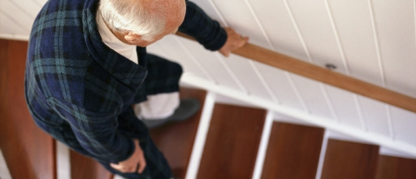
Problem Area
The main problem area identified was falling on the stairs due to:
Rushing
Improper foot placement
Falling out of rhythm
Current solutions were described as:
Bulky, slow and requiring no muscular input
or
Relied too the user’s upper body strength, whist providing little support
Mission Statement:
" to create a device to prevent an elderly person from falling on the stairs in a simple, dignified and secure manner while still promoting physical activity"

Slide 4
Our Design

Slide 5
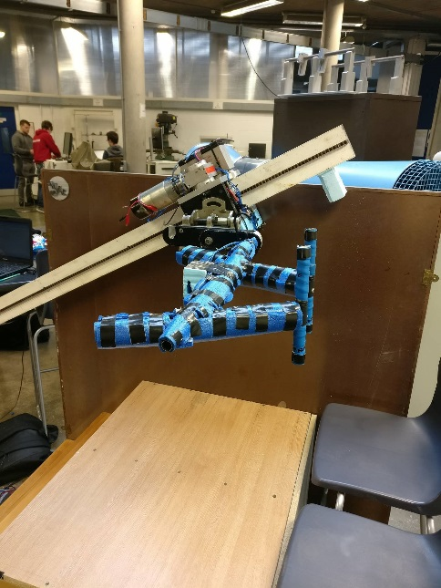
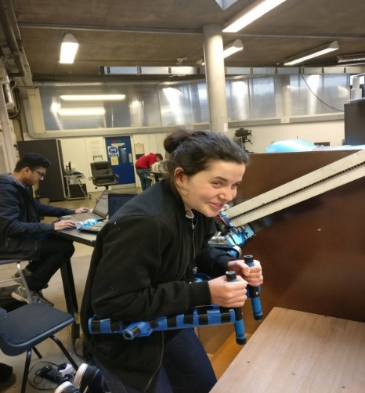
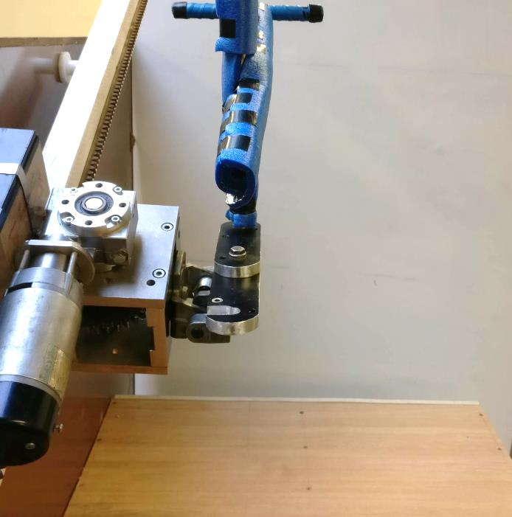
Features and Benefits
Paces with the user using ultrasonics
Adjusts height for going up and down stairs with horizontal flipping mechanism
Unique bar deign allows the user to rest on their entire forearms and hold two vertical handles, which is a more natural position, reliving stress from the user’s grip. A hook also allows for easy carrying.
Folds vertically out of the way when not in use, allowing for easy access
Built in fall detection stops movement in the event of a fall
Padding on the bar provides comfort and cushioning
Promotes muscle usage and encourages daily exercise

Slide 6
Functional Video

Slide 7
Thanks for listening!
Any Questions???

